Slide 1
Polymerase Chain Reaction
Dr Mohammed Shoeb
Assistant Professor
Department of Zoology
Govt. Dr WW Patankar Girl’s PG College, Durg

Slide 2
Introduction
Polymerase chain reaction (PCR) is a laboratory technique for rapidly producing (amplifying) millions of copies of a specific segment of DNA.
PCR was invented in 1983 by American biochemist Kary Mullis at Cetus Corporation.

Slide 3
PCR depends on thermal cycling, which exposes reagents to repeated cycles of heating and cooling to permit different temperature-dependent reactions—specifically, DNA melting and enzyme-driven DNA replication.

Slide 4
Principle of PCR
PCR amplifies a specific region of a DNA strand (the DNA target).
The target DNA amplified can be between 0.1 to 10 Kilo base pairs.
Amplification depends on the availability of substrates.

Slide 5
The PCR technique is based on the enzymatic replication of DNA.
In PCR, a short segment of DNA is amplified using primer mediated enzymes.
DNA Polymerase synthesizes new strands of DNA complementary to the template DNA.
The DNA polymerase can add a nucleotide to the pre-existing 3’-OH group only. Hence a primer is required.
DNA polymerase add nucleotides to the 3’ primer end.

Slide 6
Components of PCR
DNA Template– The DNA of interest to be amplified.
DNA Polymerase– Taq Polymerase is DNA polymerase isolated from the thermophilic bacterium Thermus aquaticus. It does not denature at high temperatures.
Oligonucleotide Primers- These are the 18 and 24 nucleotides length single-stranded DNA segments, complementary to the 3’ ends of sense and anti-sense strands.
Deoxyribonucleotide triphosphate (dNTPs) – These are the building blocks for the synthesis of DNA. There are four types of dNTPs, each using a different DNA base: dATP (adenine), dCTP (cytosine), dGTP (guanine), and dTTP (thymine).

Slide 7
Buffer System– A buffer solution provide a suitable chemical environment for optimum activity and stability of the DNA polymerase. It contain Tris-HCl buffer(pH 8.0 and 9.5), Potassium chloride (KCl) which promotes primer annealing and Magnesium chloride (MgCl₂).
PCR Tubes are transparent tubes made from Polyethylene or Polypropylene.

Slide 8
PCR machine
The PCR machine is a thermal cycler which make use of a Peltier device, which permits both heating and cooling of the block holding the PCR tubes simply by reversing the device's electric current.
The device has a thermal block with holes where tubes holding the reaction mixtures can be inserted. The cycler then raises and lowers the temperature of the block in discrete, pre-programmed steps.

Slide 9
Modern thermal cyclers are equipped with a heated lid. This prevents condensation of water from the reaction mixtures.
Some thermal cyclers are equipped with multiple blocks allowing several different PCRs to be carried out simultaneously. Some models also have a gradient function to allow for different temperatures in different parts of the block. This is particularly useful when testing suitable annealing temperatures for PCR primers.

Slide 10
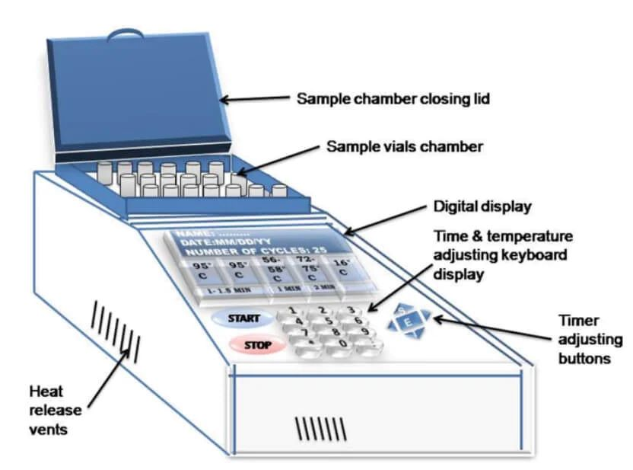
PCR Diagram

Slide 11
Process
PCR is a three step cyclic process:
Denaturation: Denaturation is separation, of the two strands of the DNA molecule. The reaction mixture is heated to 94℃ for about 30 Seconds to 2 minutes. This breaks the hydrogen bonds between the two strands of DNA and converts it into a single-stranded DNA. The single strands now act as a template for the production of new strands of DNA.

Slide 12
Annealing: The reaction temperature is lowered to 54-60℃ for around 20-40 seconds. The primers anneal to the template and serve as the starting point for the synthesis of DNA.
Elongation: The temperature is raised to 72 °C during this the DNA polymerase begins adding nucleotides onto the ends of the annealed primers. The bases are added to the 3’ end of the primer by the Taq polymerase enzyme. This elongates the DNA in the 5’ to 3’ direction. The DNA polymerase adds about 1000bp/minute under optimum conditions.

Slide 13
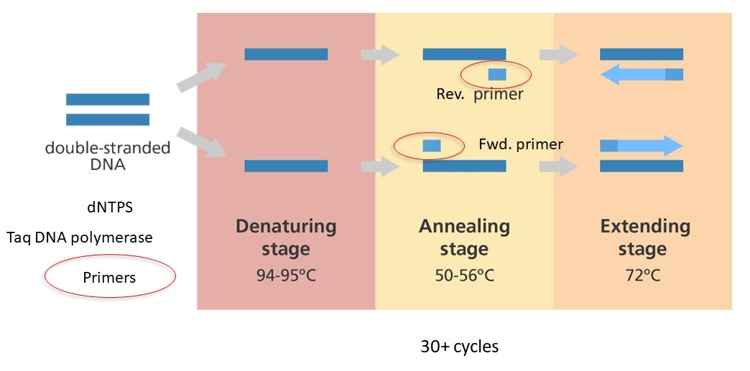

Slide 14
Types of PCR
Conventional PCR: Enables the synthesis of specific DNA fragments using a DNA-polymerase and Specific Primers.
Conventional PCR is applied in selective DNA isolation and amplification of DNA.

Slide 15
Hot Start PCR
Hot Start PCR uses modified DNA Polymerase which is inactive at room temperature. This prevents non specific amplification before start of the reaction.
Denaturation at 95ºCelsius, causes DNA melting and simultaneously, the heat from this step also activates the DNA polymerase - hence, hot start.
Hot start PCR significantly reduces non-specific binding, the formation of primer-dimers, and reduces the risk of contamination.

Slide 16
Reverse Transcription PCR
Reverse transcription polymerase chain reaction (RT-PCR) combine reverse transcription of RNA into DNA (cDNA) and amplification of specific DNA targets using polymerase chain reaction (PCR).
The technique helps in detection of gene transcripts especially in eukaryotes whose genes have intervening sequence(Introns) in genomic DNA. But mRNA and hence cDNA has only Expressed sequence (Exons).

Slide 17
Reverse Transcription PCR
In RT-PCR, the RNA template is first converted into a complementary DNA (cDNA) using reverse transcriptase. The cDNA then acts as a template for amplification using PCR.
RT-PCR can be conducted either in a single tube or as two steps in different tubes. The one-step method is more effective with fewer chances of contamination and incorporation of variations.

Slide 18
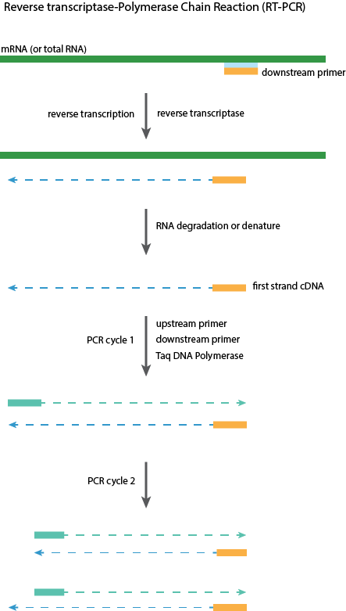

Slide 19
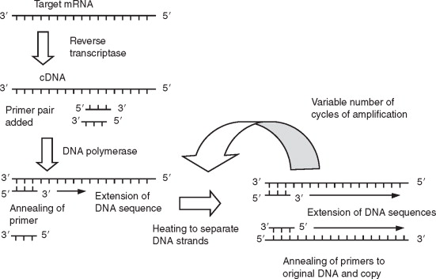

Slide 20
Quantitative Real Time PCR
Quantitative reverse transcription PCR (RT-qPCR) involves the detection and quantification simultaneously.
The process is performed by reverse transcription of total RNA or mRNA to complementary DNA (cDNA) by the enzyme reverse transcriptase, followed by amplification and detection of specific targets of this cDNA using a technique called quantitative PCR (qPCR) or real-time PCR.
At each cycle during this PCR, the quantity of DNA is measured in real-time by use either hydrolysis probes such as TaqMan® probes, or a double-stranded DNA binding dye such as SYBR® Green dye.

Slide 21
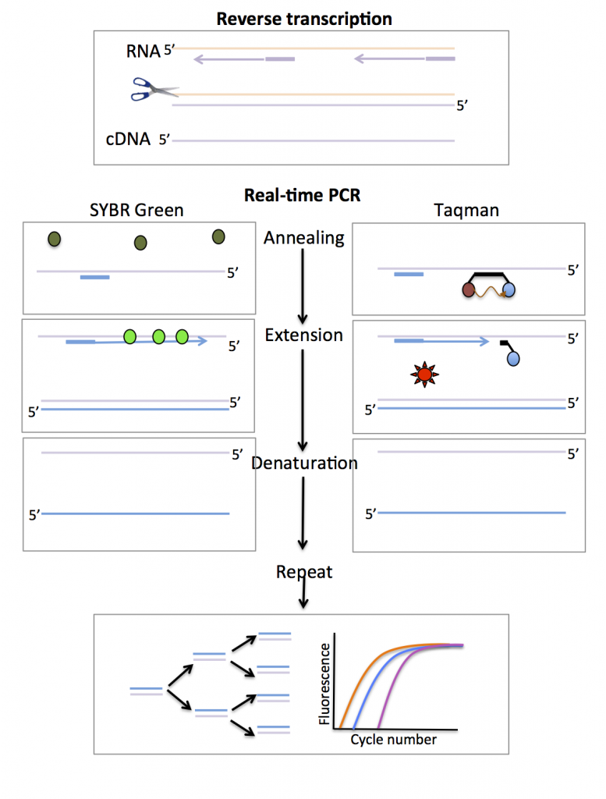

Slide 22
Applications of Quantitative Real Time PCR
Quantify gene expression levels
Validate RNAi to study loss of function of selective genes
Detect pathogens such as viruses for the diagnosis of infectious diseases
Detect genetically modified organisms (GMOs)

Slide 23
Colony PCR
Colony PCR is a method for rapidly screening colonies of yeast or bacteria to verify the presence of desired genetic construct.
It bypasses DNA isolation and restriction digest, which are traditionally used to verify DNA insertion during cloning.
Colony PCR is a Direct PCR method providing a fast, easy, and inexpensive solution for screening cloned constructs.

Slide 24
Steps of Colony PCR
Design primers to detect the presence of insert.
Set up a standard PCR reaction (primers, dNTPs, polymerase) using the supernatant of lysed bacteria as template.
Run your PCR product on a gel to analyze product size.

Slide 25
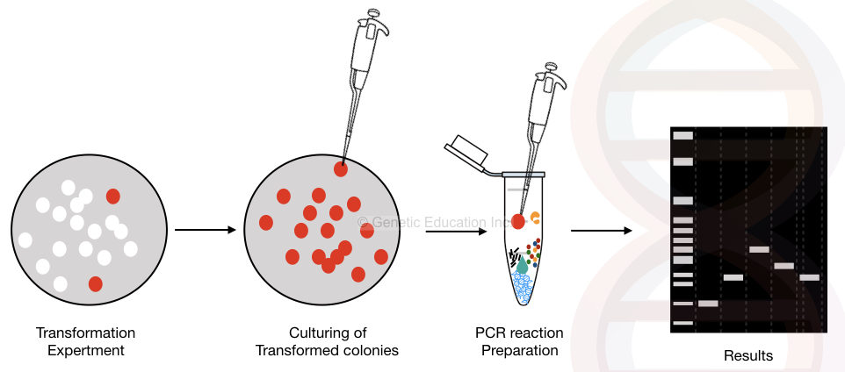
Colony PCR

Slide 26
Colony PCR is a fast and easy method to identify the presence and orientation of plasmid constructs.
Colony PCR is used in gene transfer, gene therapy, gene cloning, genetic alteration and CRISPR-CAS9-like experiments.

Slide 27
Multiplex PCR
Multiplex PCR is a common molecular biology technique used for the amplification of multiple targets in a single PCR test run.
In Multiplex PCR, multiple primers and a temperature-mediated DNA polymerase are used for the amplification of DNA in a thermal cycler.
All the primers pairs designed for Multiplex PCR have to be optimized so that the same annealing temperature is optimal for all the pairs during PCR.
This technology has been applied in many areas such as genotyping, mutation and polymorphism analysis, microsatellite STR analysis, detection of pathogens or genetically modified organisms, etc.
In diagnostic laboratories, multiplex PCR is useful to detect different microorganisms that cause the same types of diseases.

Slide 28
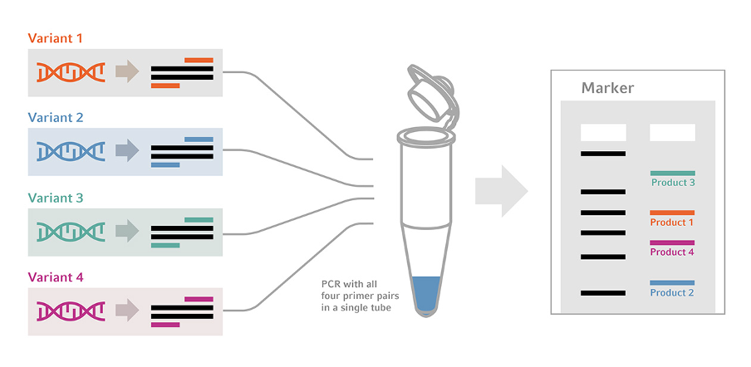
Multiplex PCR

Slide 29
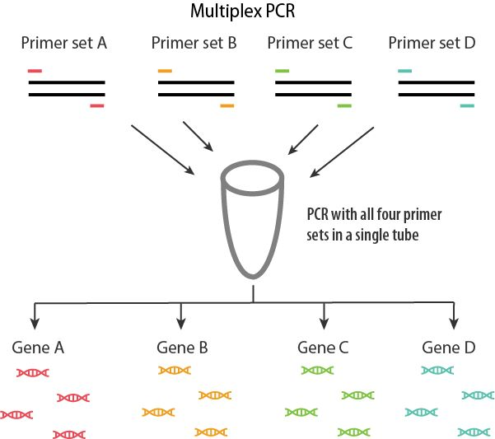
Multiplex PCR

Slide 30
Nested PCR
Nested PCR is a useful modification of PCR technology where the specificity of the reaction is enhanced by preventing the non-specific binding with the help of the two sets of primer.
The first set of primer binds outside of our target DNA and amplifies larger fragment while another set of primer binds specifically at the target site.
In the second round of amplification, second set of primer amplifies only the target DNA.
Nested PCR is a helpful method for the phylogenetic studies and detection of different pathogens.
The technique has higher sensitivity; hence even if the sample contains lower DNA, it can be amplified which is not feasible in the conventional PCR technique.

Slide 31
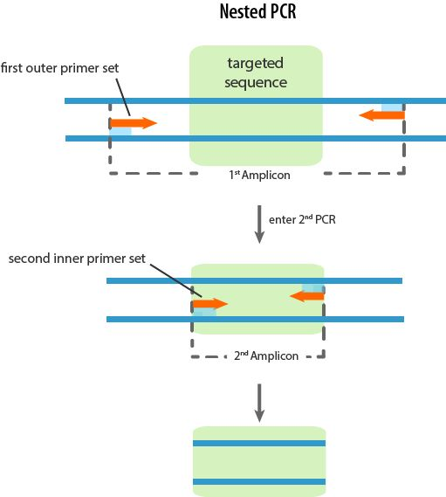
Nested PCR

Slide 32
Applications of Polymerase Chain Reaction
Identification and analysis of Gene Expression
Detection of Genetic anomalies, mutations in developing embryos
Diagnosis of bacterial, viral diseases
In forensic science to identify scene of crime DNA
DNA Finger printing
As an important augmentative method in Gene cloning, generation of hybridization probes for Northern, Southern blotting, site directed mutagenesis
Phylogenetic analysis of ancient DNA from fossils

Slide 33
Advantages of PCR
Highly specific: PCR can distinguish DNA sequences by just one nucleotide, making it a very accurate technique.
Sensitive: PCR is a very useful technique when the amount of DNA sample is limited because it allows the detection of even a single copy of a specific DNA template.
Versatile: The PCR technique can be used for various applications like genetic testing, criminal investigations, and paternity tests.
Rapid and efficient: PCR can efficiently and rapidly amplify a small amount of DNA sample to million copies in just a few hours.

Slide 34
Limitations of PCR
Contamination: The PCR technique is very susceptible to contamination from other sources of DNA or RNA or the environment. This can mislead data interpretation.
Cost and complexity: PCR can be expensive and requires expert knowledge for high-throughput projects.
Lack of novel information: Since PCR can only amplify and target specific DNA sequences targeted by the primers, PCR provides limited information and cannot detect novel DNA sequences.
Inhibition from sample content: The whole PCR cycle can be disrupted by inhibitors that co-purify with DNA, such as heme from blood samples, reducing the sensitivity of the process.
Errors in amplification: Base substitutions, indels, and other alterations in DNA sequences can lead to inaccurate amplification and hence, false results.

Slide 35
Conclusion
Overall, PCR significantly impacts many research areas but careful quality measures should be performed while designing and interpreting PCR experiments.

Slide 36
References
Text book of Biotechnology by U.Satyanarayan
Principles And Techniques Of Biochemistry And Molecular Biology by Wilson And Walker

Slide 37
References
https://www.ebi.ac.uk/training/online/courses/functional-genomics-ii-common-technologies-and-data-analysis-methods/real-time-pcr/
https://www.sigmaaldrich.com/IN/en
Freeman WM, Walker SJ, Vrana KE (January 1999). "Quantitative RT-PCR: pitfalls and potential". BioTechniques. 26 (1): 112–22, 124–5. doi:10.2144/99261rv01. PMID 9894600.
https://old.abmgood.com/marketing/knowledge_base/polymerase_chain_variation_system.php

